Slide 1
Checking and securing understanding of similar triangles
Trigonometry

Slide 2
How our teaching resources are designed for the classroom

Slide 3
I can recognise that similar shapes have sides in proportion to each other but angle sizes are preserved.

Slide 4
Two shapes are similar if the only difference between them is their size. Their side lengths are in the same proportions.
Enlargement is a transformation that causes a change of size.
Scale factor is the multiplier between similar shapes that describes how large one shape is compared to the other.

Slide 5

Checking and seuring understanding of similar triangles
Identifying similar triangles
Finding missing lengths with similar triangles

Slide 6
Identifying similar triangles
When a shape is enlarged, the angles do not change.
Therefore, similar shapes have the same angles.
53°
5 m
53°
3 m
37°
37°
4 m

Slide 7
Identifying similar triangles
When a shape is enlarged, the lengths may change. This depends on the scale factor.
Therefore, similar shapes may have different lengths.
× 2
53°
10 m
5 m
53°
3 m
× 2
6 m
37°
37°
4 m
× 2
8 m

Slide 8
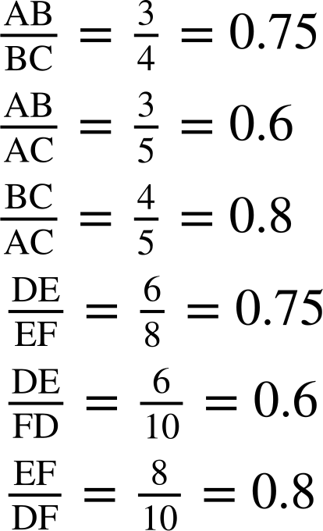
Identifying similar triangles
When a shape is enlarged, the proportions between each pair of lengths do not change.
Therefore, similar shapes have lengths in the same proportions.
× 0.6
× 0.6
53°
10 m
5 m
53°
3 m
6 m
37°
37°
× 0.8
4 m
× 0.75
8 m
× 0.75
× 0.8

Slide 9
Identifying similar triangles
The criteria for congruent triangles can be used to show that unknown lengths and angles are fixed by the measurements that are known.
These criteria can be adapted to determine similarity between triangles.
SSS
ASA
AAS
RHS
5 m
5 m
5 m
3 m
53°
53°
3 m
3 m
37°
37°
4 m
5 m
5 m
5 m
3 m
53°
53°
3 m
3 m
37°
37°
4 m

Slide 10
Identifying similar triangles
The criteria for congruent triangles can be used to show that unknown lengths and angles are fixed by the measurements that are known.
These criteria can be adapted to determine similarity between triangles.
The lengths differ but pairs of lengths remain in the same proportions.
SSS
ASA
AAS
RHS
5 m
5 m
5 m
3 m
53°
53°
3 m
3 m
37°
37°
4 m
10 m
10 m
10 m
53°
53°
6 m
6 m
6 m
37°
37°
8 m

Slide 11
Identifying similar triangles
Similarity with triangles can also be determined by all three angles.
When two triangles are similar, they have the same angles.
When two triangles have the same angles then they are similar.

Slide 12
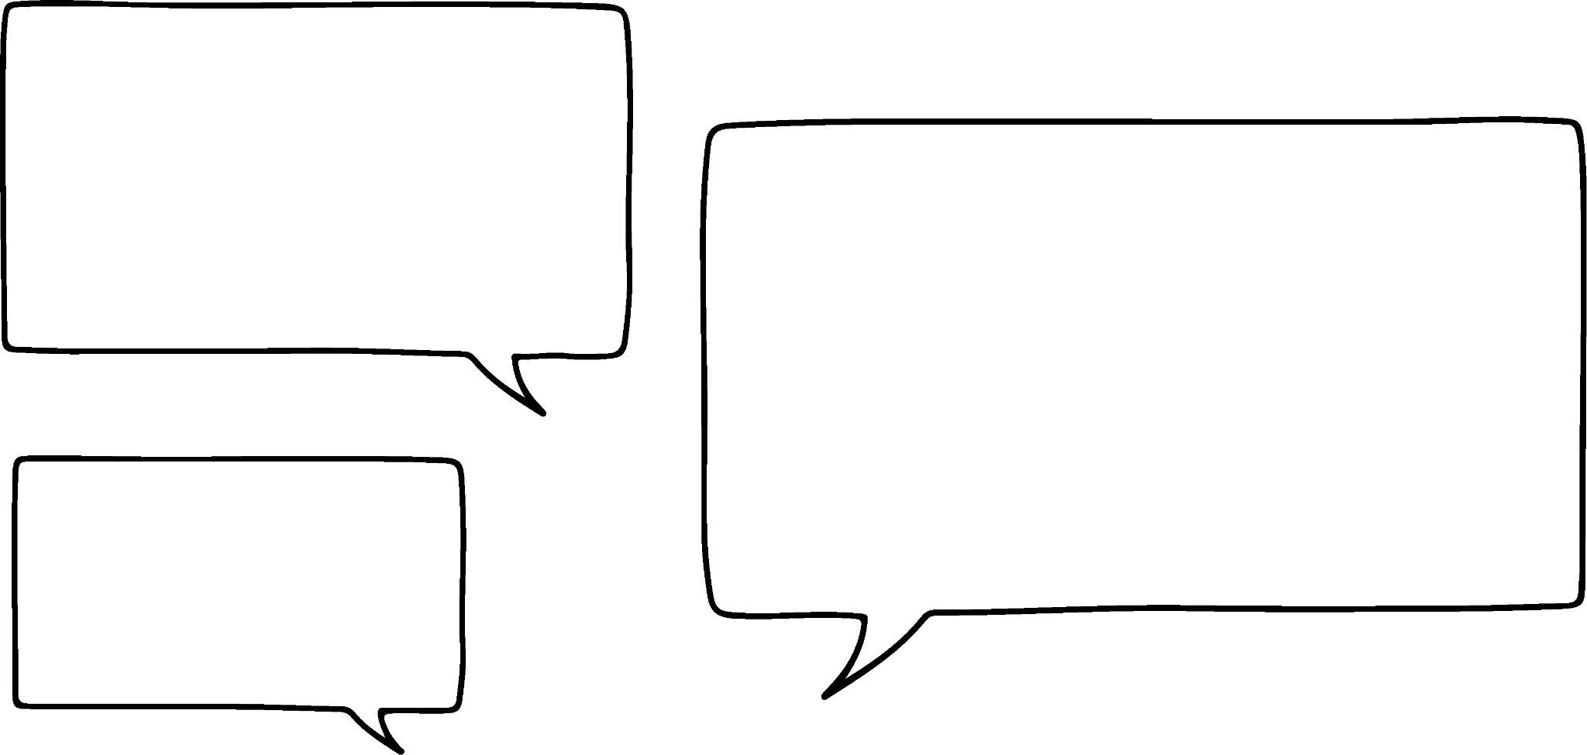


Identifying similar triangles
Is there enough information to determine that the triangles are similar?
How could we determine similarity without knowing whether the angles are the same?
× 0.8
5 cm
× 0.625
4 cm
8 cm
We could find the proportions between each pair of lengths on one triangle.
× 0.5
Aisha
7.5 cm
6 cm
5 ÷ 8 = 0.625
4 ÷ 8 = 0.5
4 ÷ 5 = 0.8
12 cm
Lucas

Slide 13
Identifying similar triangles
Is there enough information to determine that the triangles are similar?
The lengths of the triangles are in the same proportions, so the angles must be the same.
× 0.8
5 cm
× 0.625
4 cm
8 cm
× 0.8
And then check if those proportions can be found on the other triangle.
× 0.5
Aisha
7.5 cm
6 cm
5 ÷ 8 = 0.625
4 ÷ 8 = 0.5
4 ÷ 5 = 0.8
12 cm
× 0.5
× 0.625
Lucas

Slide 14


Identifying similar triangles
Is there enough information to determine that the triangles are similar?
How could we determine similarity without knowing any lengths?
45°
45°
The two triangles have the same angles, therefore their lengths must be in the same proportion. So they are similar.
83°
Jacob
52°
83°
52°
Sam

Slide 15
Identifying similar triangles
Is there enough information to determine that the triangles are similar?
We only know two angles this time. Can we still determine similarity?
We can see two of the angles are the same in each triangle. That means the third angle must also be the same. We could check by finding the missing angle in each.
30°
75°
75°
Jacob
So, the triangles are similar.
30°
Sam

Slide 16




Identifying similar triangles
Is there enough information to determine that the triangles are similar?
We have a right-angle and we know the lengths of the hypotenuse and another side (RHS).
6 m
4 m
If the lengths were the same then we could prove that they are congruent.
Jun
That would mean that the triangles have the same angles and there is only one possible length for the third edge.
12 m
Alex
6 m
8 m
4 m
Laura

Slide 17
Identifying similar triangles
Is there enough information to determine that the triangles are similar?
The two known lengths of the large triangle are both double their corresponding lengths in the small triangle.
6 m
4 m
We can use RHS to establish that there is only one possible length for the remaining edge in the large triangle.
x m
× 2
× 2
Jun
× 2
12 m
Therefore this edge must also be twice the length of its corresponding edge.
Alex
8 m
2x m
Laura

Slide 18

Identifying similar triangles
Is there enough information to determine that the triangles are similar?
6 m
The triangles are similar!
4 m
The triangles are similar!
Jun
12 m
The triangles are similar!
Alex
8 m
Laura

Slide 19

Identifying similar triangles
Which statement is true?
6 m
The triangles are similar.
30°
The triangles are not similar.
30°
9 m
There is not enough information to determine similarity.

Slide 20
Identifying similar triangles
Which statement is true?
12 m
6 m
The triangles are similar.
The triangles are not similar.
9 m
There is not enough information to determine similarity.
18 m

Slide 21
Identifying similar triangles
Which statement is true?
12 m
6 m
The triangles are similar.
30°
30°
The triangles are not similar.
30°
30°
9 m
There is not enough information to determine similarity.
18 m

Slide 22
Identifying similar triangles
1) For each triangle, write a tick if it is similar to △ABC, a cross if it is not similar and a question mark if there is not enough information to determine similarity. Diagrams are not drawn accurately and all lengths are given in the same units.
A
a)
b)
c)
55
50
45
30
35
21
37°
37°
37°
C
B
28
32
40
44
d)
e)
f)
g)
60
37°
52
48
48
37°
60
39

Slide 23

Identifying similar triangles
1) For each triangle, write a tick if it is similar to △ABC, a cross if it is not similar and a question mark if there is not enough information to determine similarity. Diagrams are not drawn accurately and all lengths are given in the same units.
A
a)
b)
c)
55
50
45
30
35
21
37°
37°
37°
C
B
28
32
40
44
d)
e)
f)
g)
60
37°
52
48
48
?
37°
60
39

Slide 24
Checking and securing understanding of similar triangles
Identifying similar triangles
Finding missing lengths with similar triangles

Slide 25

Finding missing lengths with similar triangles
The two triangle below are similar.
This could be proven by finding the remaining angle.
If a second length is known on one triangle, its corresponding length on the other triangle can be found by using proportional reasoning.
Method 1:
= 1.25
× 1.25
20 m
16 m
60°
60°
× 1.25
y m
y = 8 × 1.25 = 10
8 m
30°
30°

Slide 26

Finding missing lengths with similar triangles
The two triangle below are similar.
This could be proven by finding the remaining angle.
If a second length is known on one triangle, its corresponding length on the other triangle can be found by using proportional reasoning.
Method 2:
× 0.5
= 0.5
× 0.5
20 m
16 m
8 m
y m
y = 20 × 0.5 = 10
30°
30°

Slide 27
Finding missing lengths with similar triangles
Scale factors and multipliers within triangles can be easier to find when there is an edge with a length of 1 unit.
E.g. find the value of x and y.
Method 1:
x = 0.87 × 20 = 17.4
× 20
20 m
1
y m
× 20
0.5
y = 0.5 × 20 = 10
30°
30°
0.87
× 20
x m

Slide 28
Finding missing lengths with similar triangles
Scale factors and multipliers within triangles can be easier to find when there is an edge with a length of 1 unit.
E.g. find the value of x and y.
Method 2:
× 0.5
x = 20 × 0.87 = 17.4
× 0.5
20 m
1
y m
0.5
× 0.87
× 0.87
y = 20 × 0.5 = 10
30°
30°
0.87
x m

Slide 29
Finding missing lengths with similar triangles
As one of the triangles has an edge with length 1 unit, it may be easier to spot proportional relationships within the triangles rather than calculating the scale factor between the triangles.
Inverse operations can be used to find the value of x.
× 0.5
× 0.5
x m
12 m
1
÷ 0.5
0.5
x = 12 ÷ 0.5 = 24
30°
30°

Slide 30
Finding missing lengths with similar triangles
Find the value of y.
12 ÷ 10 = 1.2
y = 7.5 × 1.2 = 9
× 0.75
× 0.75
× 1.2
12 m
or
10 cm
y m
7.5 m
× 1.2
7.5 ÷ 10 = 0.75
y = 12 × 0.75 = 9
49°
49°

Slide 31
Finding missing lengths with similar triangles
Find the value of x.
x = 0.7 × 12 = 8.4
× 12
12 m
or
1
× 0.7
x = 0.7 × 12 = 8.4
× 0.7
49°
49°
× 12
x m
0.7

Slide 32
Finding missing lengths with similar triangles
Find the value of x.
x = 12 ÷ 0.7 = 17.1
x m
÷ 0.7
1
× 0.7
× 0.7
49°
49°
0.7
12 m

Slide 33
Finding missing lengths with similar triangles
When a triangle is enlarged, the multipliers between pairs of lengths remain the same.
This can be seen when triangles are nested and when they are drawn separately.
× 0.5
1
0.5
30°
4
× 0.5
3
× 0.5
× 0.5
4
2
× 0.5
2
2
× 0.5
1.5
1
1
0.5
30°
30°

Slide 34
Finding missing lengths with similar triangles
A pair of similar triangles can be made from a single triangle by taking measurements part-way along some of its edges.
x m
x m
÷ 0.75
1 m
× 0.75
1 m
× 0.75
0.75 m
3.9 m
3.15 m
0.75 m
3.9 m
3.9 m
x = 3.95 ÷ 0.75 = 5.27

Slide 35
Finding missing lengths with similar triangles
A tall pole is held upright by some ropes. Sam wants to work out the height of the pole.
I can’t measure all the way up the pole or all the way along a rope.
x m

Slide 36
Finding missing lengths with similar triangles
A tall pole is held upright by some ropes. Sam wants to work out the height of the pole.
I can’t measure all the way up the pole or all the way along a rope.
But I can measure the distance along the floor.
x m
8 m
How could similar triangles help Sam with this problem?

Slide 37
Finding missing lengths with similar triangles
A tall pole is held upright by some ropes. Sam wants to work out the height of the pole.
I could measure 1 m along ground from where the rope meets the floor.
At that point, I could measure the vertical distance between the rope and the floor.
x m
0.75 m
1 m
8 m

Slide 38
Finding missing lengths with similar triangles
A tall pole is held upright by some ropes. Sam wants to work out the height of the pole.
I then have a pair of nested similar triangles, which I can use to find the height of the pole.
x m
0.75 m
x = 8 × 0.75 = 6
1 m
× 0.75
8 m
× 0.75
The pole is 6 m tall.

Slide 39
Finding missing lengths with similar triangles
What is the value of x?
2.2
x m
3.2
4 m
1 m
4
0.8 m
5

Slide 40
Finding missing lengths with similar triangles
1) All lengths are given in cm. Find the values of the unknowns.
1
2
24°
0.4
1.5
d
24°
b
e
24°
24°
2.5
0.9
a
c
1.2
24°
1.8
66°
j
f
1.8
24°
24°
h
1.8
i
g

Slide 41
Finding missing lengths with similar triangles
2) Find the values of x, y and z.
z m
1.4 m
x m
1 m
0.55 m
11 m
1 m
0.7 m
y m
1.4 m

Slide 42
Finding missing lengths with similar triangles
1) All lengths are given in cm. Find the values of the unknowns.
1
2
24°
0.4
1.5
d
24°
b
e
24°
24°
2.5
0.9
a
c
a = 1.35
b = 0.6
c = 1.8
d = 0.8
e = 1
1.2
24°
1.8
66°
j
f
1.8
24°
24°
h
1.8
i
g
f = 1.62
g = 2
h = 4.5
i = 3
j = 2.7

Slide 43
Finding missing lengths with similar triangles
2) Find the values of x, y and z.
z m
1.4 m
x m
1 m
0.55 m
11 m
1 m
0.7 m
y m
1.4 m
x = 6.6
y = 0.98
z = 2

Slide 44
Checking and securing understanding of similar triangles
An enlargement is a transformation that causes a change in size.
When an object is enlarged, the image is similar. The lengths may change but their proportions within the shape are fixed. The angles do not change.
Just as with congruent triangles, not all lengths and angles need to be known to determine whether two triangles are similar.
If two triangles have the same angles then they are similar.
The proportional relationship between similar triangles and within similar triangles can be used to find missing lengths.

Slide 45

© Oak National Academy 2024.
Produced in partnership with Mathematics in Education and Industry.
Licensed on the Open Government Licence v3.0, except where otherwise stated. See Oak terms and conditions.

